Slide 1
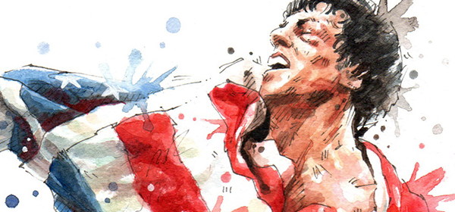
Image credit: MGM/UA Entertainment Company
Improving Student Learning Behaviors
and Attainment through Incorporation
of Pop Culture
presented by: Mandy Northcutt, MS, CPT
03/14/18
AState.edu
/ArkansasState
@ArkansasState

Slide 2
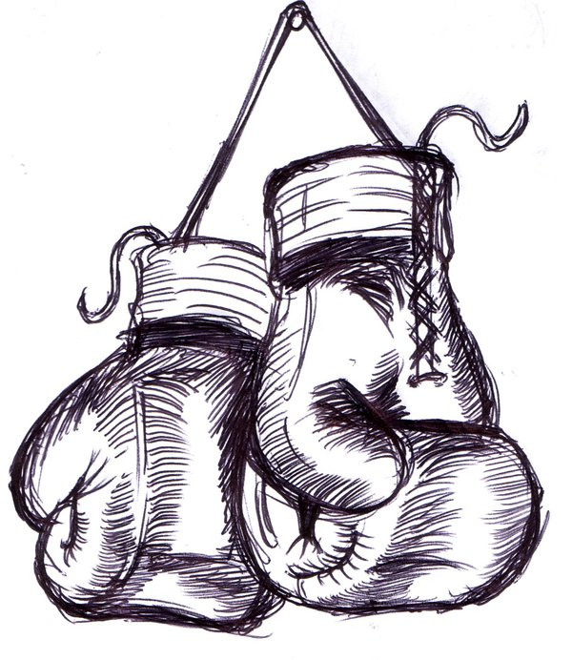
Ding Ding – Round 1
The Why.
AState.edu
/ArkansasState
@ArkansasState
Image credit: FreeImageDesigns.com

Slide 3
Ding Ding – Round 2
The How.
AState.edu
/ArkansasState
@ArkansasState
Image credit: FreeImageDesigns.com

Slide 4
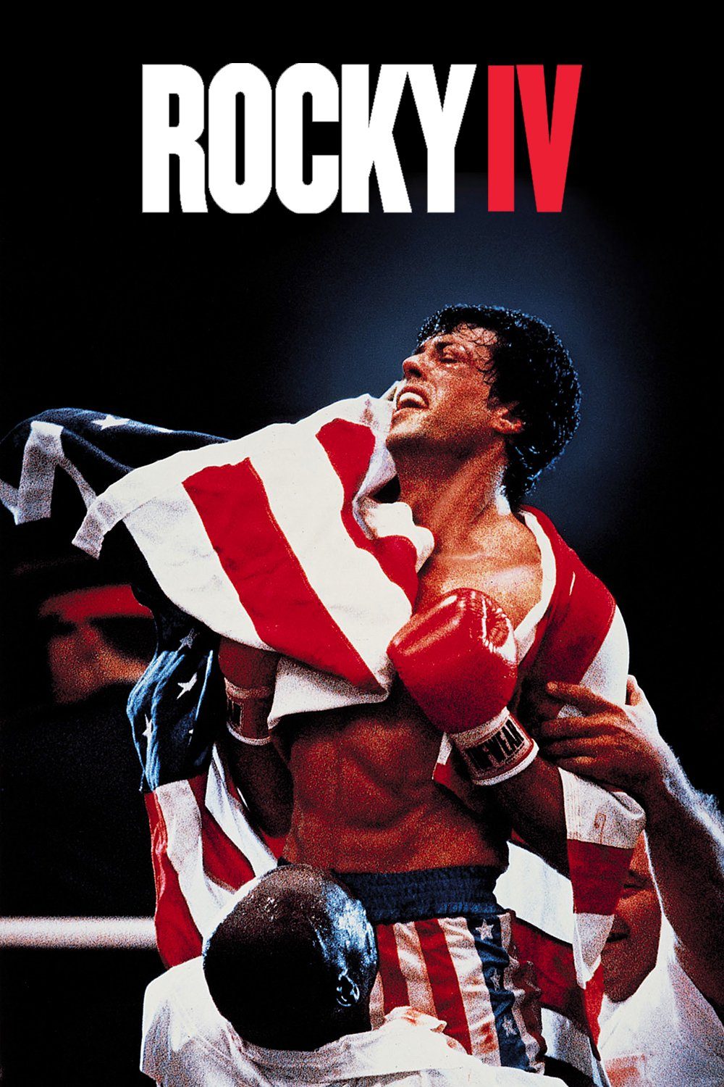
ROCKY IV MODEL
Two Parts
Individual Paper
Needs Analysis
Identification of Exercises (Rocky/Drago)
Physiological Responses
Discussion/Conclusion
Oral Group Presentation / Debate
Define Stance with Their Fighter
Provide Evidence to Support Stance
Able to Challenge Opposing Team’s Stance
When Challenged – Able to Support their
Rationale with Further Supporting Information.
Image credit: MGM/UA Entertainment Company
AState.edu
/ArkansasState
@ArkansasState

Slide 5
Ding Ding – Final
The Final Decision.
AState.edu
/ArkansasState
@ArkansasState
Image credit: FreeImageDesigns.com

